Slide 1

Patient Record Management System
ADVANCED JAVA PROGRAMMING
(AMICSE0601/ACSE0601/ACSEH0601)
Department of Computer Science and Engineering
M.Tech Int. /CSE-R
(Submitted To: Mr. Surya Prakash Sharma)
Group Members
Name of Member | Roll Number | Role | Department n Section
Keshab Kumar | 2201330100132 | Team Leader and Project Manager | CSE-B
Avarnita Srivastava | 2201330100078 | Developer | CSE-B
Advanced JAVA Programming Project PPT 2024-25 Even Sem

Slide 2
Index
Introduction
Literature Survey/Existing System
Problem Statement
Proposed Statement
Proposed Methodology
Flowcharts and Use Case/ ER Diagrams
Feasibility Study
Hardware/ Software Requirement
Results and Conclusion
References
Live Demonstration of Project with screenshots in ppt
Advanced JAVA Programming Project PPT 2024-2025 Even Sem

Slide 3
Introduction
The Travel Planner and Booking Application is a comprehensive web-based platform designed to simplify the travel experience for users. It allows users to explore destinations, plan personalized itineraries, and book flights, hotels, and local activities—all in one place. Built using Java Servlets, JSP, JDBC, and the Spring Framework, the application integrates seamlessly with third-party travel APIs and secure payment gateways. Users can register, manage trips, and receive destination suggestions based on their interests and budget. The platform also includes an admin panel for managing users and bookings efficiently. It aims to offer a one-stop solution for hassle-free travel planning and booking.
Advanced JAVA Programming Project PPT 2024-25 Even Sem

Slide 4
Literature Survey / Existing System
Existing travel planning systems primarily focus on individual services like flight or hotel bookings, often requiring users to visit multiple platforms to complete a single trip plan. This fragmented approach leads to inefficiencies, redundant data entry, and a lack of personalized user experience. While some platforms offer online bookings, they often lack integration with real-time itinerary planning, destination discovery, or activity suggestions based on user preferences.
Moreover, most systems do not maintain comprehensive user profiles or travel history that could aid in personalized recommendations. There are very few unified systems that offer a complete end-to-end solution for destination exploration, bookings, activity scheduling, and secure payments within a single application. Hence, a web-based, centralized travel planning system that streamlines the entire process—from discovery to booking—was found essential to improve user experience and efficiency.
Advanced JAVA Programming Project PPT 2024-25 Even Sem

Slide 5
Problem Statement
Planning a trip often involves using multiple platforms for discovering destinations, booking flights, reserving hotels, and organizing activities, resulting in a disjointed and time-consuming experience. The lack of integration among these services leads to redundant data input, confusion, and inefficient trip management. Additionally, most existing platforms do not offer personalized itinerary planning based on user preferences or travel history. There is a clear need for a centralized, user-friendly application that streamlines the entire travel planning and booking process while offering customization, real-time updates, and secure payment handling..
Advanced JAVA Programming Project PPT 2024-25 Even Sem

Slide 6
Proposed Methodology
The proposed system will be developed using Java Servlets, JSP, JDBC, and the Spring Framework to create a modular, scalable, and maintainable travel booking platform. It will follow the MVC architecture for efficient separation of concerns. Users will be able to register, discover destinations, and book flights, hotels, and activities. Integration with third-party travel APIs will provide real-time data, while secure payment gateways like Razorpay or Stripe will handle transactions. An admin panel will manage users and bookings. The system will undergo rigorous testing before deployment on a server using Apache Tomcat or Spring Boot.
Advanced JAVA Programming Project PPT 2024-25 Even Sem

Slide 7
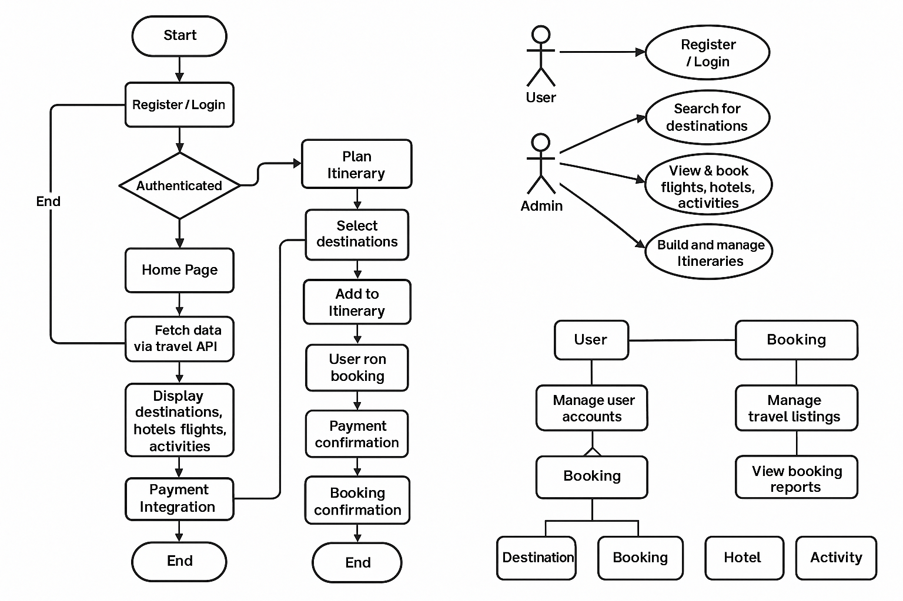
Flowcharts and Use Case / ER Diagrams
Flowchart: ER Diagram:

Slide 8
Feasibility Study
Technical Feasibility: The application utilizes Java Servlets and JSP for dynamic content generation, JDBC for database interaction, and Spring Framework for integration and scalability. It connects with external travel APIs for real-time flight, accommodation, and activity data, while payment gateways handle secure transactions. This tech stack ensures scalability, reliability, and smooth integration with third-party services.
Economic Feasibility: The use of open-source technologies like Java, Spring, and JDBC keeps development costs low. Travel API and payment gateway integrations are cost-effective, with scalable pricing models. The system can be hosted on affordable cloud platforms, with the option to scale as needed, making the project financially viable for small businesses or travel agencies.
Operational Feasibility: The application simplifies trip planning for users, allowing them to discover destinations, book flights, accommodations, and activities in one place. The user interface is intuitive, requiring minimal effort for trip planning. Admins can manage bookings, update data, and track revenue easily through a backend dashboard. The system reduces manual work, streamlines processes, and ensures a smooth, efficient user experience.
Advanced JAVA Programming Project PPT 2024-25 Even Sem

Slide 9
Hardware / Software Requirement
Hardware / Software Requirements
1. Hardware Requirements:
Server: Multi-core processor (Intel i5 or equivalent), 8-16 GB RAM, 100 GB SSD storage, 1 Gbps internet for hosting.
Client: Desktop, laptop, or mobile device with a modern browser (Chrome, Firefox, Safari, Edge) and reliable internet.
2. Software Requirements:
Backend: Java (JDK 8+), Spring Framework, Apache Tomcat/Jetty, Hibernate ORM, JDBC.
Frontend: HTML5, CSS3, JavaScript, AJAX, Bootstrap (optional).
Database: MySQL or PostgreSQL.
Third-Party Integrations: Travel APIs, Payment Gateway APIs (Stripe, PayPal).
Development Tools: IntelliJ IDEA/Eclipse/NetBeans, Git, Maven/Gradle.
Testing: JUnit/TestNG, Selenium.
Hosting: AWS/Heroku/Google Cloud, SSL Certificates, CI/CD tools (Jenkins, GitLab CI).
Advanced JAVA Programming Project PPT 2024-25 Even Sem

Slide 10
Results and Conclusion
The trip planning application successfully integrates real-time data from travel APIs, allowing users to easily discover destinations and book flights, accommodations, and activities. It enhances operational efficiency by automating tasks and streamlining the booking process. With secure payment gateway integration and a user-friendly interface, the system improves both user experience and administrative workflow. The project is technically sound, cost-effective, and scalable, making it a valuable solution for the travel industry. Overall, it is a feasible and efficient tool for both users and administrators.
Advanced JAVA Programming Project PPT 2024-25 Even Sem

Slide 11
References
Oracle. Java Platform, Standard Edition Documentation. https://docs.oracle.com/javase/8/docs/
Spring Framework. Official Documentation. https://spring.io/projects/spring-framework
Apache Tomcat. Servlet Container Documentation. https://tomcat.apache.org/
MySQL. Database Documentation. https://dev.mysql.com/doc/
Mozilla Developer Network (MDN). HTML5, CSS3, and JavaScript Documentation. https://developer.mozilla.org/
PayPal Developers. Payment Gateway Integration Guide. https://developer.paypal.com/
Stripe Developers. Online Payment API Reference. https://stripe.com/docs
Amadeus for Developers. Travel APIs Documentation. https://developers.amadeus.com/
GitHub. Open-source examples and project references. https://github.com/
W3Schools. Web Development Tutorials and Examples. https://www.w3schools.com/
Advanced JAVA Programming Project PPT 2024-25 Even Sem

Slide 12
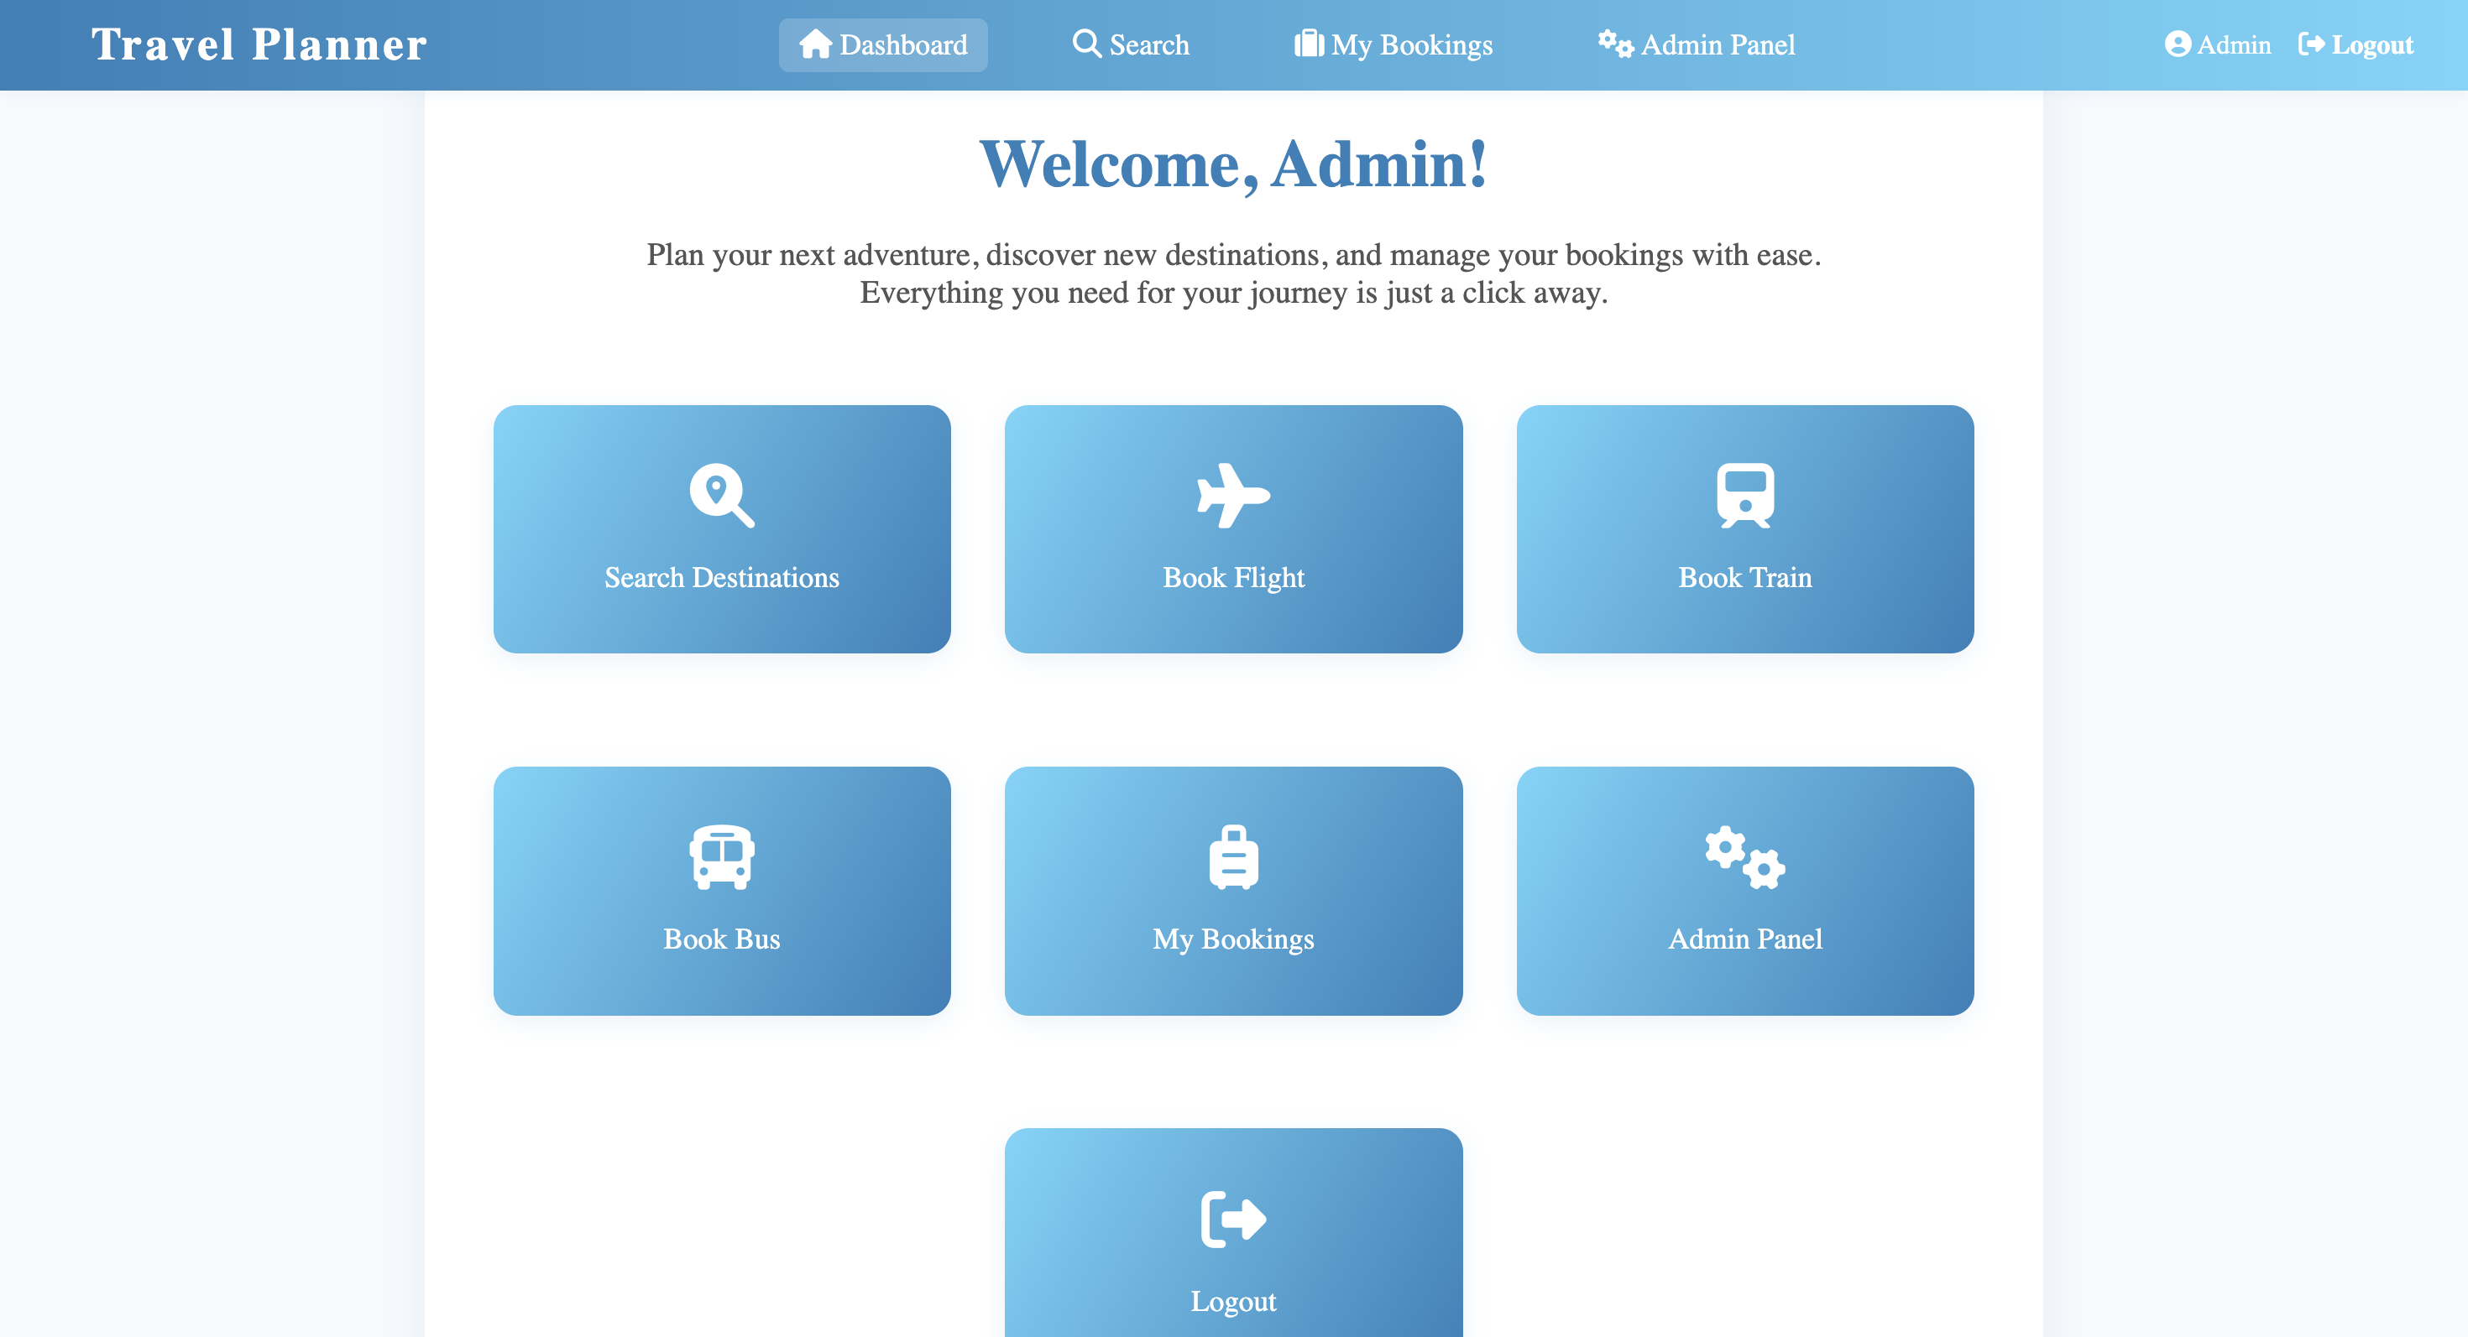
Live Demonstration
.

